Slide 1


.NET MAUI Introducción

Slide 2

Virtual Talks4Kids 2020
www.talks4kids.com

Slide 3

Javier Suárez
Software Developer at Microsoft
Blog: http://geeks.ms/blogs/jsuarez
Email: javiersuarezruiz@hotmail.com
Twitter: @jsuarezruiz

Slide 4


.NET
Tu plataforma para crear cualquier cosa
Escritorio
Web
Cloud
Móvil
Gaming
IoT
AI
Notes:
.NET is a free, cross-platform, open source developer platform for building many different types of applications. With .NET, you can build for web, mobile, desktop, gaming, and IoT.
.NET enables developers to be more productive building applications of any type, for any device.

Slide 5





.NET – Plataforma unificada
HERRAMIENTAS
ESCRITORIO
WEB
CLOUD
MÓVIL
GAMING
IoT
AI
VISUAL STUDIO
VISUAL STUDIO FOR MAC
.NET STANDARD
LIBRERÍAS
VISUAL STUDIO CODE
INFRAESTRUCTURA
CLI
COMPONENTES RUNTIME
COMPILADORES
LENGUAJES
Notes:
With .NET Standard we can share libraries easily across all these types of applications. Today .NET cover workloads we never had before, like Linux workloads and Machine Learning & AI.

Slide 6

El viaje hacia un único .NET
Notes:
Now let’s talk about the future…..

Slide 7

Es hora de evolucionar

Slide 8
– De .NET 5 a 6 "
La vision de un único .NET
.NET Framework
SDK único, un único BCL, herramientas unificada
Interfaz de usuario nativa multiplataforma
Interfaz de usuario web multiplataforma
Mejoras relacionadas con la nube
Continuar mejorando en rendimiento, tamaño, opciones de diagnóstico, servicios de Azure
.NET
.NET Core
Mono / Xamarin
.NET ofrece soluciones para todas las opciones
Notes:
The vision for one .NET is to simplify the platform and choices for .NET developers and provide a single stack that supports the best of breed solutions for all modern workloads.
Last year at Build, we said we would take .NET Core and Mono/Xamarin implementations and unify them into one base class library (BCL) and toolchain (SDK).
We will have these featuresin preview for the .NET 5 release but the unification will be truly completed with .NET 6, our Long-Term Support (LTS) release. Our vision has not changed, but our timeline has.
.NET 5 will have several cloud & web investments.

Slide 9
Introducción de .NET Multi-platform App UI
Interfaz de usuario nativa multiplataforma
Proyecto único, base de código único
Implementar en múltiples dispositivos, dispositivos móviles y escritorio
Evolución de Xamarin.Forms
.NET 6, Previews de fin de año
.NET MAUI
.NET Platform
Crea interfaces de usuario nativa para cualquier dispositivo
github.com/dotnet/maui
Notes:
I’m excited to talk about .NET Multi-platform App UI, or just .NET MAUI.
<CLICK>
It is a cross-platform, native UI stack so you’ll get great performance on any device.
<CLICK>
It will allow you to build these apps for any device from a single codebase and project system
<CLICK>
And that includes desktop and mobile across operating systems, like Windows, MacOS, iOS and Android.
<CLICK>
This is the evolution of Xamarin technology, building on Xamarin.Forms and expanding that to cross-platform desktop scenarios.
<CLICK>
It will be part of the unified .NET in the .NET 6 timeframe with previews available end of this year. You’ll see us working on it in the open on GitHub.

Slide 10

.NET MAUI
.NET Platform
Notes:
I’m also excited to announce .NET Multi-platform App UI, or just .NET MAUI.
<CLICK>
It is a cross-platform, native UI stack so you’ll get great performance on any device.
<CLICK>
It will allow you to build these apps for any device from a single codebase and project system
<CLICK>
And that includes desktop and mobile across operating systems, like Windows, MacOS, iOS and Android.
<CLICK>
This is the evolution of Xamarin technology, building on Xamarin.Forms and expanding that to cross-platform desktop scenarios.
<CLICK>
It will be part of the unified .NET in the .NET 6 timeframe with previews available end of this year. You’ll see us working on it in the open on GitHub.

Slide 11
.NET MAUI
System.Maui evolución de Xamarin.Forms
System.Devices evolución de Xamarin.Essentials
File | New
Multi-platform App UI (.NET)
CLI
dotnet new maui
Notes:
The are some important changes when .NET MAUI will be part of unified .NET like:
Xamarin.Forms will evolve and can be found in System.Maui.
While, in System.Devices we can find an evolution of Xamarin.Essentials.
If you don’t know about Xamarin.Essentials, it provides developers with cross-platform APIs for their mobile applications.
There are APIs to retrieve orientation information from the device or detect the current system theme.

Slide 12
.NET para iOS y Android
Xamarin.iOS --> .NET para iOS
Xamarin.Android --> .NET para Android
Los namespaces & APIs no cambiarán con respecto a las APIs existentes en UIKit & Android APIs
File | New (SDK style)
CLI
dotnet new ios
dotnet new android
Notes:
What happens to Xamarin.iOS and Xamarin.Android?
Xamarin.iOS will become .NET for iOS and Xamarin.Android will become .NET for Android.

Slide 13

Creando la UI con .NET MAUI
Notes:
Let's move on to an important topic, perhaps one of the points with the most feedback right now from the community, let's see how we can create the user interface with .NET MAUI.

Slide 14
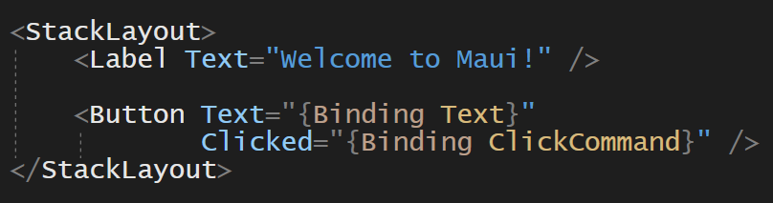
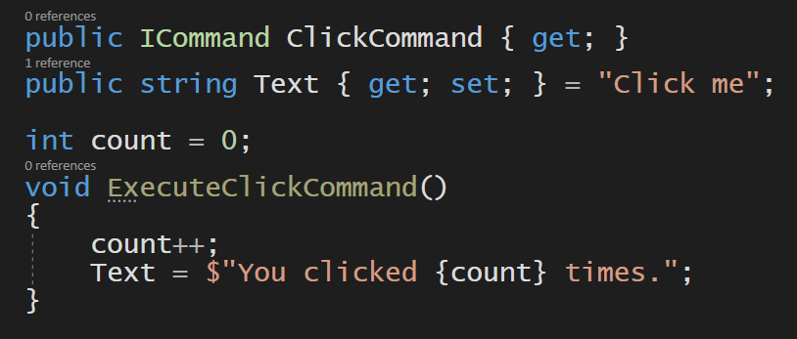
Creando la UI con .NET MAUI
Puedes seguir usando XAML y MVVM
Notes:
If you knew Xamarin.Forms you probably knew that you could define the UI with C# and XAML. If you like XAML to define the user interface, of course you can continue using it.

Slide 15
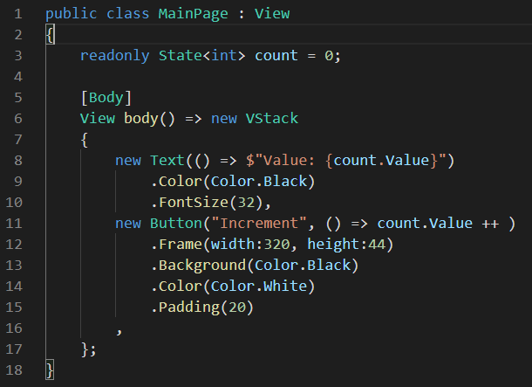
Creando la UI con .NET MAUI
C# para describir la UI
Hay desarrolladores que crean la UI usando diferentes patrones (React Native, Flutter, etc.)
Model-View-Update (MVU): simplifica el enlace de datos
Hot Reload: guarda el código y ver la actualización de la App al instante
Notes:
In addition, we are enabling developers to write fluent C# UI and implement the increasingly popular Model-View-Update (MVU) pattern.
MVU promotes a one-way flow of data and state management, as well as a code-first development experience that rapidly updates the UI by applying only the changes necessary.

Slide 16
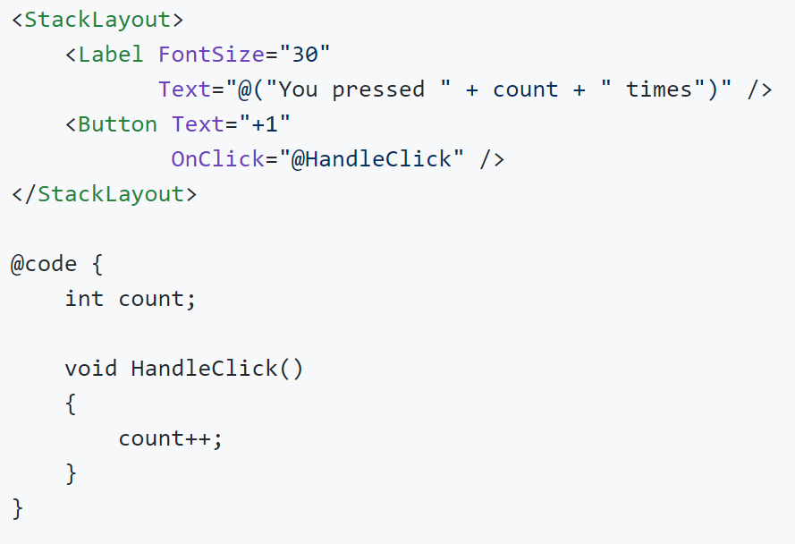
Creando la UI con .NET MAUI
Blazor para describir la UI (en investigación)
Es una opción interesante para desarrolladores web.
Sintaxis de Razor: simplifica el enlace de datos.
Prueba Blazor Mobile Bindings hoy: https://github.com/xamarin/MobileBlazorBindings

Slide 17

Herramientas
Notes:
There are still parts being defined or evolving but there are important improvements related to tooling, let's see them!

Slide 18
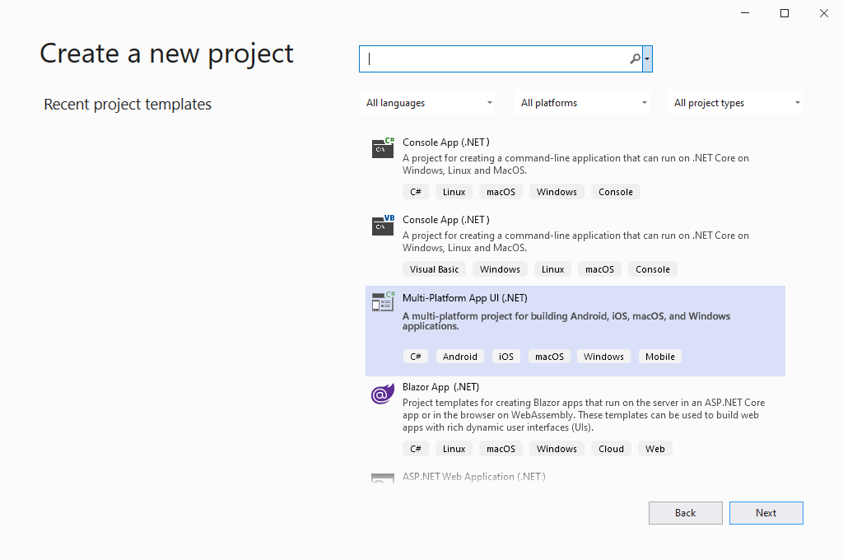








Slide 19
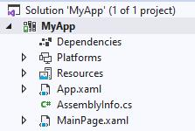
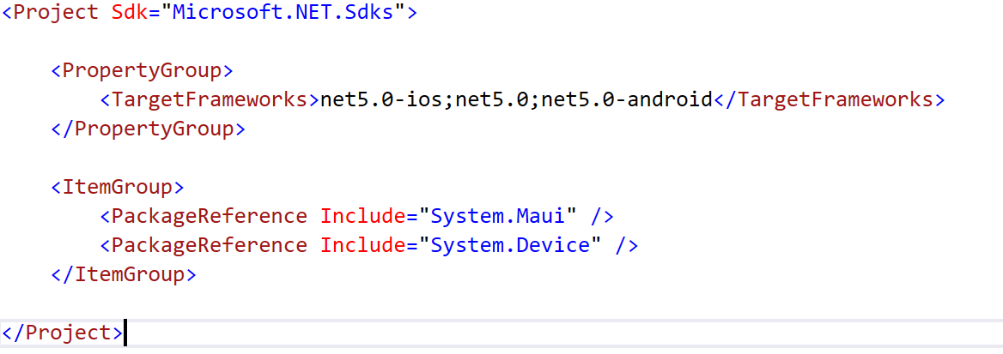
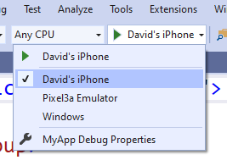
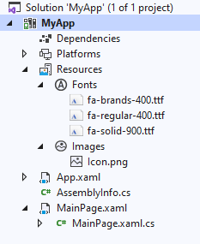
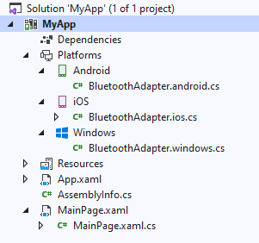
MAUI: Desarrollo simplificado
Notes:
We’ve done many things to make developers more productive than ever – we made it a simplified project structure, and that’s what this looks like, a single project!
Built on .NET SDK
Simplified project file – and you can see our new namespaces, Maui and Devices (which is the evolution of essentials)
And, you’ll be able to deploy to any target right from VS, without toggling which CPU or project is your startup project!
The first thing we’ll do is bring all your fonts, images, and resources into that same exact single project – I’ve added font awesome, and an icon
You have access to 100s of APIs with System.Device and .NET but sometimes you need to get the native stuff. But now right in this you get to the specifics and all your native APIs are right htere
No more different project heads – you’ll be able to put your custom work right in platforms in the single project

Slide 20
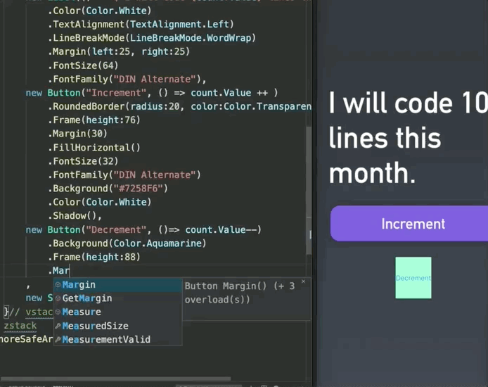
DEMO
Muchos cambios para que los desarrolladores sean más productivos que nunca:
Utilizando una estructura de proyecto simplificada.
Visual Studio para Windows, Visual Studio para macOS y compatibilidad con Visual Studio Code.
Soporte de MVU.
Hot Reload.
Etc.
Notes:
This is a very simple demo, as you can see it is practically a counter, but we have a great variety of details and new functionallity here:
- On the one hand we see the use of fluent C# code to define the UI.
- Hot Reload with C# code to see the changes on the fly in the simulator.
- Visual Studio Code! Is being used.

Slide 21

Funcionalidad
Notes:
Let’s talk about one of my favorite topics, the new features.

Slide 22
La nueva arquitectura de Renderers
Xamarin.Forms
System.Maui
Forms.Button
UIKit.UIButton or AppKit.NSButton
AndroidX.AppCompat.Widget.
AppCompatButton
Windows.UI.Xaml.Controls.
Button
Forms.VisualElement
MaciOS.
ButtonRenderer
Android.
ButtonRenderer
UWP.
ButtonRenderer
Maui.IButton
Maui.
ButtonRenderer.
MaciOS
UIKit.UIButton or AppKit.NSButton
Maui.
ButtonRenderer.
Android
Maui.
ButtonRenderer.
UWP
AndroidX.AppCompat.Widget.
AppCompatButton
Windows.UI.Xaml.Controls.
Button
Maui.IView
Notes:
The main objectives with the new renderers architecture are:
Simplified project structure, easier for us and contributors to navigate
Middle purple layer can be swapped out for your chosen architecture (e.g., MVVM + XAML, MVU + C#, Blazor)
Initially the Xamarin.Forms renderers have parent element (usually a Layout) was used to define options related to the element (size, etc.). Later renderers were created for the most used controls without the need for this parent element, reducing the visual tree, and improving performance. This was called fast renderers and in .NET MAUI all renderers will be fast renderers.
Invert the dependency and make renderers more consistent and easier to
hook into.
In Xamarin.Forms, sometimes there are an override, other times not an override
and we want to create a really consistent structure.
In the actual Xamarin.Forms renderers, you have a Forms Button and
this Button is a BindableObject, is a structure similar to the UWP structure,
and then the renderers depend on the Forms Button and have a deep knowledge of
how the BindableObject works (INPC, this is not neccesary for MVU).
With the new renderer architecture the idea is invert the dependency, so,
all the renderers are now based on interfaces. Now, you have a representation of what should be a Button
and then we can define that Button (Forms style, MVU).
Instead, renderers having Forms Core and know about BO, etc.; .NET MAUI Core has
a reference to the renderers.
This reduce the coupling between the UI definition and the native implementation. The new renderers works just with pure interfaces,
Allowing to take any UI paradigm

Slide 23
Xamarin.Forms: Añadir un Custom Behavior
Every platform project…
// You need to know to export this renderer and tie it to a core type…
[assembly: ExportRenderer (typeof(MyEntry), typeof(MyEntryRenderer))]
namespace CustomRenderer.iOS {
// You need to know what type to inherit from…
public class MyEntryRenderer : EntryRenderer {
// You need to know what method to override…
protected override void OnElementChanged (ElementChangedEventArgs<Entry> e) {
// You need to know when to do your work (before? after?)
base.OnElementChanged (e);
// You need to know that we call the native view “Control”
// Spoiler alert: this varies from platform to platform and
// sometimes it even varies from renderer to renderer!
if (Control != null) {
// Finally! We can change the color!
Control.BackgroundColor = UIColor.FromRGB (204, 153, 255);
}
}
}
}
Core project
public class MyEntry : Entry
{
}
Notes:
Relying on event handlers to orchestrate behavior and property changes
Lots of boilerplate code
Tons of knowledge required about order of events, both on the platform side and on the Xamarin.Forms side (i.e,, Does this need to happen on ElementChanged? What about ElementPropertyChanged? Etc.)

Slide 24
Maui: Personalizar un Renderer
EntryRenderer.iOS.cs
// You don’t need to register a new renderer.
public partial class EntryRenderer
{
// You know what method to call because you named it!
public static void MapBackgroundColor (IViewRenderer renderer, IView view)
{
// You don’t need to call any base methods here or worry about order.
// Every renderer is consistent; you know where the native view is.
var nativeView = (NativeView)renderer.NativeView;
var color = view.BackgroundColor;
if (color != null) {
// Phew! That was easy!
nativeView.BackgroundColor = UIColor.FromRGB (204, 153, 255);
}
}
}
EntryRenderer.cs
public partial class EntryRenderer {
public static PropertyMapper<IView> ViewMapper = new PropertyMapper<IView> {
// Add your own method to map to any property
[nameof(IView.BackgroundColor)] = MapBackgroundColor
};
}
Notes:
You don’t actually have to make this specific to iOS. You could actually make an extension method that changes the background color for each platform, and this mapping can live in one shared partial class…even less code!
Way easier to unit test, much less specific knowledge required about the inner workings of Maui to do something simple as change a color.

Slide 25
Maui: Personalizar un Renderer
App.cs
ButtonRenderer.ButtonMapper[nameof(Ibutton.TextColor)] = (x, y) =>
{
if(x is MyCustomButton)
{
// Add your own logic to map the TextColor property
}
else
{
}
};

Slide 26
Más funcionalidad
Más opciones de personalización (sombras, CornerRadius, etc.).
Microsoft.Extensions.Hosting.
Soporte de transiciones entre páginas y elementos visuales.
Soporte de múltiples ventanas.
Mejoras en el ciclo de vida de la aplicación.
Mejoras en animaciones.
Paridad en funcionalidad en macOS y Windows.
Etc.
Danos tu feedback!
github.com/dotnet/maui
Notes:
In Xamarin.Forms we will have new features next versions such as the possibility of creating shapes, clip views using shapes, gradients, new controls like a TabView, or an improved version of Shell. Of course, all this functionality will be also available in .NET MAUI.
We really want to give the same possibilities when creating desktop applications,for that we will have functionality parity in macOS and WIndows. Also will include multi-window support.
Will have many more visual options.

Slide 27
Comparativa
 | Xamarin.Forms | MAUI
Plataformas
Android | API 19+ | API 21+
iOS | 9 – 14 | 10+
Linux (GTK#) | Community | Community
macOS | Community | Microsoft
Tizen | Samsung | Samsung
Windows | UWP Microsoft WPF Community | Microsoft
Características
Renderers | Acoplado a BindableObject | Desacoplado, no Core deps
App Models | MVVM / RxUI | MVVM / RxUI / MVU
Single Project | No | Si
Multi-Targeting | No | Si
Multi-Window | No | Si
Misc
.NET | X.iOS, X.Android, UWP, … | .NET 6 +
Project System | Franken-Proj | SDK Style
dotnet CLI | No | Si
Herramientas
Visual Studio 2019 | Si | Si
Visual Studio 2019 for Mac | Si | Si
Visual Studio Code | No | Si

Slide 28
El Roadmap de .NET
Dic 2019
.NET Core 3.1
LTS
Nov 2020
.NET 5.0
Nov 2021
.NET 6.0
LTS
Nov 2022
.NET 7.0
Nov 2023
.NET 8.0
LTS
.NET 5.0 saldrá en Noviembre 2020
.NET 6.0 + .NET MAUI
Notes:
Predictable releases helps everyone, not only the businesses that use .NET but also the open source projects that are built upon .NET.

Slide 29
¿Preguntas?
Notes:
There are still parts being defined or evolving but there are important improvements related to tooling, let's see them!

Slide 30

Gracias a todos!

